Slide 1
Chris Hixon, Coach Aaron Feis, and Coach Scott Beigel Guardian Program
Education Program

Slide 2
Why the Guardian Program Was Created
The Marjory Stoneman and Douglas public safety commission found that having guardians in schools is the best way to ensure, highly trained personnel are in place to respond immediately in the event of a school shooting.

Slide 3
Establishing the Guardian Program
On February 14, 2018, a gunman took the lives of 17 people at Marjory Stoneman Douglas High School in Parkland, Florida. As a result, the legislature passed a bill creating the Chris Hixon, Coach Aaron Feis, and Coach Scott Beigel Guardian Program in honor of those who gave their lives during this tragedy.

Slide 4
Become involved with the Guardian Program
Please contact your local sheriff’s office or superintendent for more information regarding upcoming trainings and becoming a guardian.

Slide 5
30.15 Powers, duties, and obligations.
Sheriffs are tasked with assisting district school boards and charter school governing boards in providing access to a Guardian Program to aid in the prevention or abatement of active assailant incidents on school premises.
Any person certified as a school Guardian has no authority to act in any law enforcement capacity, except to the extent necessary to prevent or abate an active assailant incident.

Slide 6
30.15 Powers, duties, and obligations.
If a local school board has voted to implement a Guardian Program, the Sheriff in that county shall establish the program to provide training, either directly or through a contract with another Sheriff's office that has established a Guardian program.
If a charter school governing board wishes to implement a Guardian program and the county Sheriff denies the request, the governing board may contract with a Sheriff in a different county.

Slide 7
1006.12 Safe-school school resource officers at each public school.
Each district school board and superintendent shall partner with law enforcement agencies or security agencies to assign one or more safe-school officers at each school facility within the district, including charter schools. District school boards must collaborate with charter school governing boards to facilitate charter school access to all safe-school officer options available. The school district may implement any combination of the options to best meet the needs of the district and charter schools.

Slide 8
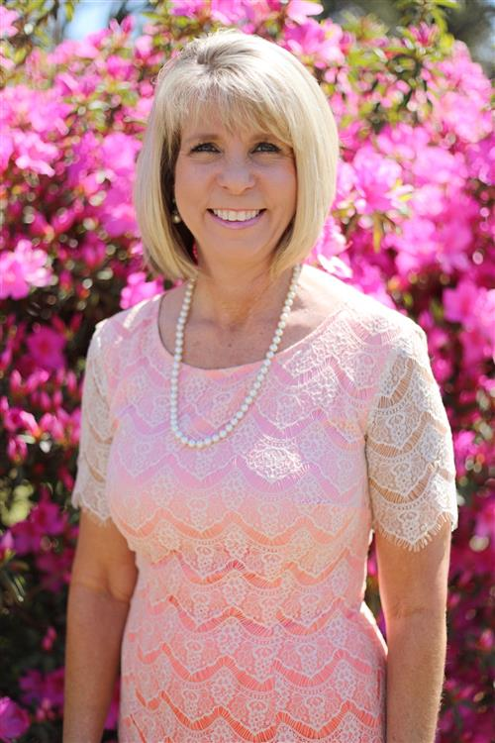
Baker County Guardian Program
“Our community is very thankful for these individuals, and their dedication to the safety of our students and employees.” - Superintendent Sherrie Raulerson
Click here to view a brief testimonial.

Slide 9
Safe-School Officer Options

Slide 10
Safe-School Officers
School Resource Officers - Certified law enforcement officers who are employed by a law enforcement agency.
School Safety Officers - Law enforcement officers certified by a law enforcement agency or by the district school board. A school safety officer has the power to arrest persons under the same conditions that deputy Sheriffs are authorized to make arrests.

Slide 11
Guardians
A school district or charter school employee or personnel, including teachers, who volunteers to serve as a school Guardian in addition to his or her official job duties.
An employee of a school district or a charter school who is hired for the specific purpose of serving as a school Guardian.

Slide 12
Contracted Private Security Guards
A school district or charter school governing board may contract with a private security agency to employ an individual who holds a Class “D” and Class “G” license, provided the security guard has completed the Guardian training program.

Slide 13

Pasco County Guardian Program
“It is a phenomenal working relationship because we train together, our tactics are the same, our procedures are the same... and if God forbid that worst day happens, we are in the best possible scenario to protect our students and our teachers.” -
Sheriff Nocco
Click here to view a brief testimonial.

Slide 14
Training and Screening Requirements

Slide 15
Guardian Training
Each Guardian candidate must complete a 144-hour training program, consisting of 12 hours of a certified nationally recognized diversity training and 132 total hours of comprehensive firearm safety and proficiency training conducted by Criminal Justice Standards and Training Commission-certified instructors.
Though these are the minimum requirements, some Sheriffs’ offices may choose to require additional hours.

Slide 16
Statutory Requirements
Eighty hours of firearms instruction based on the Criminal Justice Standards and Training Commission’s Law Enforcement Academy training model, which must include at least 10 percent but no more than 20 percent more rounds fired than associated with academy training. Program participants must achieve an 85 percent pass rate on the firearms training.

Slide 17
Title
Statutory Requirements
Eight hours of discretionary shooting instruction using state-of-the-art simulator exercises.
Sixteen hours of instruction in active shooter or assailant scenarios.
Eight hours of instruction in defensive tactics.
Four hours of instruction in legal issues.
Sixteen hours of instruction in precision pistol.

Slide 18
Screening
Candidates must pass a psychological evaluation administered by a licensed psychologist designated by the Department of Law Enforcement and submit the results of the evaluation to the Sheriff's office.
Submit to and pass an initial drug test and subsequent random drug tests in accordance with the statutory requirements and the Sheriff's office.
Successfully complete ongoing training, weapon inspection, and firearm qualification on at least an annual basis.

Slide 19
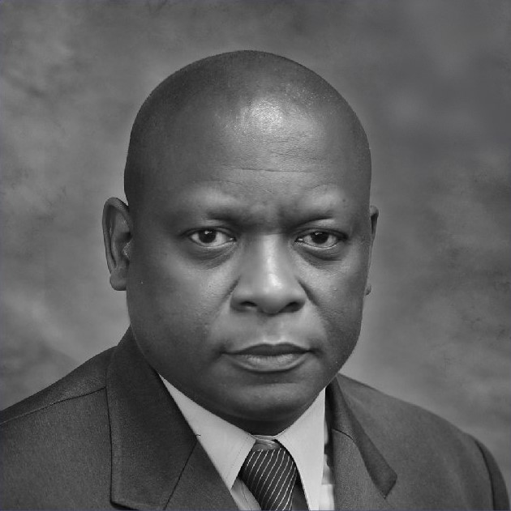
Suwannee County Guardian Program
“The benefit to our community is that, folks in our county realize that we are serious about school security, and we are serious about protecting our students. We have had great success with the program.” –
Malcolm Hines, School Safety Specialist
Click here to view a brief testimonial.

Slide 20
Certification

Slide 21
Training shall be provided by a Sheriff's office once the district school board and Sheriff's office approve implementing the Guardian Program.
The Sheriff shall issue a school Guardian certificate to individuals who meet the statutory requirements.
The Sheriff shall maintain documentation of weapon and equipment inspections, as well as the training, certification, inspection, and qualification records of each school Guardian appointed by the Sheriff.

Slide 22
Recertification
Guardians must be recertified on an annual basis. Any expenses incurred by the Sheriff's office to facilitate recertification are eligible for reimbursement by the FDOE using Guardian Program grant funds.
Recertification requirements are determined by the Sheriff’s office responsible for the initial certification, in conjunction with the Department of Law Enforcement.

Slide 23
Funding
In 2018, the legislature appropriated funding for grants to Sheriffs’ offices who establish a Guardian program. Initially, $500,000 in recurring funds was appropriated for guardians; since 2021, $6,500,000 has been made available for each subsequent funding period.

Slide 24
Funding Allocation
Funds are provided to Sheriff's offices for screening-related and training-related costs, as well as to provide a one-time stipend of $500 to district and charter school employees, personnel, and teachers who volunteer to serve as a Guardian.
Any expenses incurred by the Sheriff's office related to screening, training, or stipends is eligible to be submitted to the Department of Education for reimbursement.

Slide 25
Grant Reimbursement Process

Slide 26
Initial Approval
Request for Application (RFA) submitted to FDOE by Sheriff's Office
RFA routed for approval
Documentation
Request for reimbursement submitted
Award provided to Sheriff's Office
Amendments handled accordingly
Receipts, invoices, etc. submitted electronically
Contract Summary Form executed

Slide 27





Slide 28
FAQ’s
Q: Would Guardians openly carry their firearms or keep them concealed?
A: Each district has their own preferred method, some have Guardians open carry, and some have concealed carry.
Q: Would the public know which individuals are Guardians?
A: Some districts choose to have their Guardians wear uniforms, whereas some have them wear plain clothes.

Slide 29
Q: Are school districts required to participate in the Guardian program?
A: No, a school district may choose to satisfy the safe-school officer requirement by appointing any combination of a school resource officer, a school safety officer or a school Guardian.
Q: Can individuals be trained elsewhere if the local Sheriff's office denies a request to establish a program?
A: That individual may contract with another Sheriff's office that has established a Guardian program, given the superintendent and local Sheriff's office has been notified.

